Slide 1


Company Overview
Nevvar Hickmet, Managing Partner
January, 2019

Slide 2


Company Overview
|truData
Capabilities across (cloud) Analytics, Data Science/Artificial Intelligence, and Big Data.
Headquartered in San Diego with capabilities across the US, Europe and India.
Services include Strategy and Roadmapping, Project Implementation, Staff Augmentation and Application Managed Services.
Over seventy -five Architects and Engineers with Leading Practices across multiple industries.
2018, truData Solutions, LLC All rights reserved

Slide 3





Our Experience
|truData
2018, truData Solutions, LLC All rights reserved

Slide 4
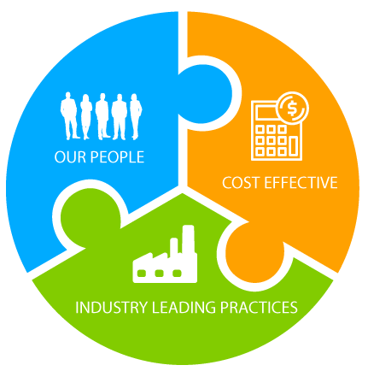
Our Differentiators
|truData
Proven Resources – our employees and network.
Leading Practices – decades of industry experience.
Trusted Partner - our objective is to ensure the overall success of our clients Business Critical initiative.
Cost Effective Resources – our optimized business model ensures the right people at the right price.
2018, truData Solutions, LLC All rights reserved

Slide 5

Contact
BI Program Strategy |truData
Nevvar Hickmet
Managing Partner
nhickmet@trudatasolutions.com
(760) 704 9969
Jon Myklebust
Senior Partner Cloud Analytics and Big Data
jmyklebust@trudatasolutions.com
Scott Redman
Senior Partner Recruiting and Operations
sredman@datahub.partners
(619) 917 7718
2018, truData Solutions, LLC All rights reserved

